Slide 1
Software Development Life Cycle (SDLC)

Slide 2
Software Crisis
Developing software within a certain schedule and maintaining its quality is still difficult.
Software projects that are large, complicated, poorly specified, and involve unfamiliar aspects, are vulnerable to large, unanticipated problems
Development of software is different from manufacturing other products.
e.g. employing more manpower (programmers) later in the software development does not always help speed up the development process.
rather, it may have negative impacts sometimes- like delay in achieving the scheduled targets, degradation of software quality, etc.

Slide 3
Software Crisis Cause
Bad planning or run time decisions.
Lack of documentation.
Improper assessment.
Incorrect estimates of needed resources.
Impractical project goals.
Not a good communication among customers, developers and users.
Use of undeveloped technology.
Not a good project management

Slide 4
Software Crisis Problem
The causes of the software crisis could be linked to the overall complexity of the software development process.
The crisis manifested itself in several ways:
Projects running over-budget.
Projects running over-time.
Software was very inefficient.
Software was of low quality.
Software often did not meet requirements.
Projects were unmanageable and code difficult to maintain.
Software was never delivered

Slide 5
Software Development Life Cycle (SDLC)
It is the division of software development work into distinct phases (or stages) containing activities with the intent of better planning and management.
SDLC for short, is a well-defined, structured sequence of stages in software engineering to develop the intended software product.
SDLC provides a series of steps to be followed to design and develop a software product efficiently. SDLC framework includes the following steps which are shown in the next slide:

Slide 6
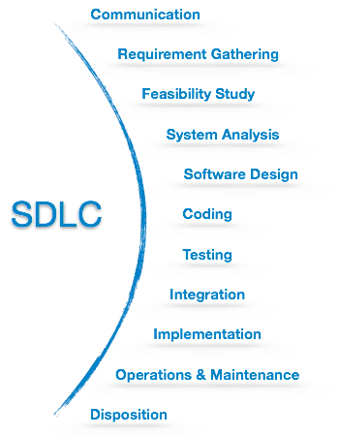

Slide 7
Communication
This is the first step where the user initiates the request for a desired software product.
He contacts the service provider and tries to negotiate the terms.
He submits his request to the service providing organization in writing.

Slide 8
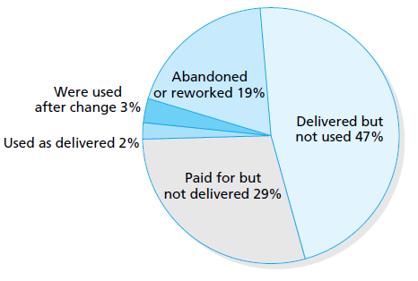
Requirement Gathering

Slide 9
Requirement Gathering
This step onwards the software development team works to carry on the project.
The team holds discussions with various stakeholders from problem domain and tries to bring out as much information as possible on their requirements.
The requirements are contemplated and segregated into-
-user requirements,
-system requirements
-functional requirements,
-non-functional requirements.

Slide 10
Types of Requirement
Functional Requirements :
We develop projects/software to meet functional requirements.
These requirements are the desired functionality that the client want us to build and delivered to them.
A functional requirement describes an interaction between the system and its environment.
Let’s just say, decide the inputs to the system and output from the system considering all internal and external factors involved.
A document is created logging all details which contains what a certain system has to do to achieve a certain specific objective.

Slide 11
Types of Requirement
Non-functional requirements:
Non-functional requirements are the untold part of the project which are not communicated but readily understood as a Global standard.
These can be understood as a support system of functional requirements.
These are the expectations of client to showcase the product as a global product following global guidelines.

Slide 12
Types of Requirement
A nonfunctional requirement can be described as a constraint on the system that like page load speed which can be optimized up-to a certain extent.
Non functional requirements can be limited to Response time, security, reliability, accuracy, capacity and availability. Clients has to decide on all these parameters and take a call to achieve a workable.

Slide 13
Requirement Collecting
The requirements are collected using a number of practices as given -
Studying the existing or obsolete system and software,
Conducting interviews of users and developers.
Survey is the good technique to collect requirements within short period of time. In this technique it is necessary to decide goal of survey and then frame questions list.
Referring to the database or collecting answers from the questionnaires.

Slide 14
Requirement Collecting
Subject Experts are responsible for brainstorming. They find out solutions on complex problems.
In observation technique responsible person observes workers in working environment for getting idea regarding software then document their observation at one place.
Build multiple use cases to describe each action that a user will take in the new system.
Prototypes can be built to show the client what the end product will look like. Tools like Omnigraffle, HotGloo are great for this part of the process.

Slide 15
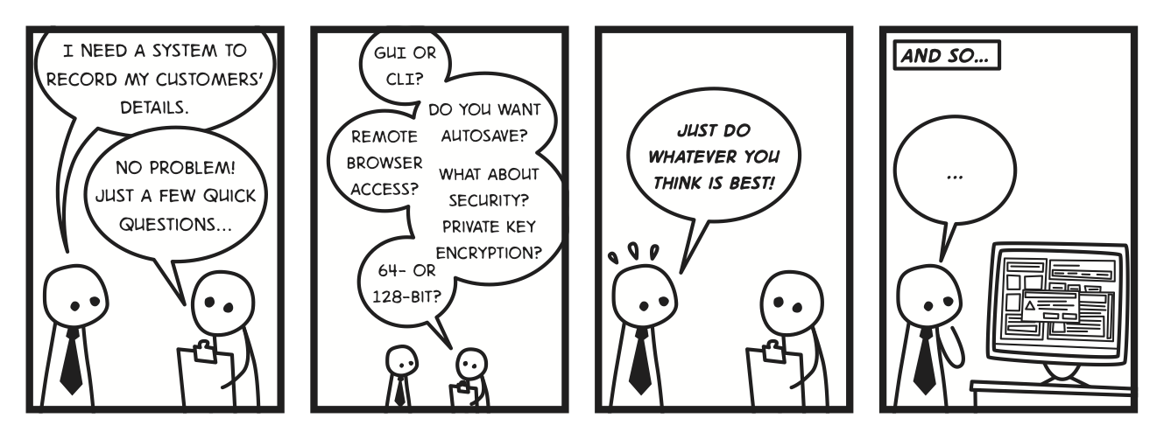

Slide 16
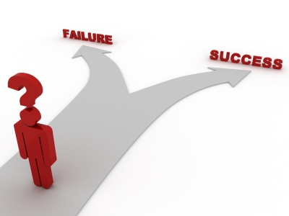
Feasibility Study
After requirement gathering, the team comes up with a rough plan of software process.
At this step the team analyzes if a software can be made to fulfill all requirements of the user and if there is any possibility of software being no more useful.
It is found out, if the project is financially, practically and technologically feasible for the organization to take up. There are many algorithms available, which help the developers to conclude the feasibility of a software project.

Slide 17
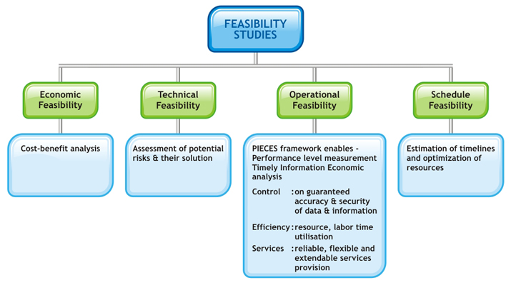

Slide 18
Feasibility Study
Advantages of making Feasibility study:
This study being made as the initial step of software development life cycle has all the analysis part in it which helps in analyzing the system requirements completely.
Helps in identifying the risk factors involved in developing and deploying the system.
The feasibility study helps in planning for risk analysis.
Feasibility study helps in making cost/benefit analysis which helps the organization and system to run efficiently.

Slide 19
Feasibility Study
Feasibility study helps in making plans for training developers for implementing the system.
So a feasibility study is a report which could be used by the senior or top persons in the organization. This is because based on the report the organization decides about cost estimation, funding and other important decisions which is very essential for an organization to run profitably and for the system to run stable.

Slide 20
System Analysis
At this step the developers decide a roadmap of their plan and try to bring up the best software model suitable for the project.
System analysis includes understanding of software product limitations, learning system related problems or changes to be done in existing systems beforehand, identifying and addressing the impact of project on organization and personnel etc.
The project team analyzes the scope of the project and plans the schedule and resources accordingly.

Slide 21
Design
Next step is to bring down whole knowledge of requirements and analysis on the desk and design the software product.
The inputs from users and information gathered in requirement gathering phase are the inputs of this step.
The output of this step comes in the form of two designs-
- logical design, and
-physical design.
Engineers produce meta-data and data dictionaries, logical diagrams, data-flow diagrams, and in some cases pseudo codes.

Slide 22
Coding
This step is also known as programming phase.
The implementation of software design starts in terms of writing program code in the suitable programming language and developing error-free executable programs efficiently.

Slide 23
Testing
An estimate says that 50% of whole software development process should be tested.
Errors may ruin the software from critical level to its own removal.
Software testing is done while coding by the developers and thorough testing is conducted by testing experts at various levels of code such as module testing, program testing, product testing, in-house testing and testing the product at user’s end.
Early discovery of errors and their remedy is the key to reliable software.

Slide 24
Integration
Software may need to be integrated with the libraries, databases and other program(s).
This stage of SDLC is involved in the integration of software with outer world entities.

Slide 25
Implementation
This means installing the software on user machines. At times, software needs post-installation configurations at user end.
Software is tested for portability and adaptability and integration related issues are solved during implementation.

Slide 26
Operation and Maintenance
This phase confirms the software operation in terms of more efficiency and less errors. If required, the users are trained on, or aided with the documentation on how to operate the software and how to keep the software operational.
The software is maintained timely by updating the code according to the changes taking place in user end environment or technology.
This phase may face challenges from hidden bugs and real-world unidentified problems.

Slide 27
Disposition
As time elapses, the software may decline on the performance front. It may go completely obsolete or may need intense upgradation. Hence a pressing need to eliminate a major portion of the system arises.
This phase includes archiving data and required software components, closing down the system, planning disposition activity and terminating system at appropriate end-of-system time.

